Slide 1

Data Science Presentation
Presented By
Md Mehedi Hasan
ID : 221-15-5976

Slide 2
Contents
Box Plot
Five Summary Measures
Fisher Linear Discrimination Function

Slide 3
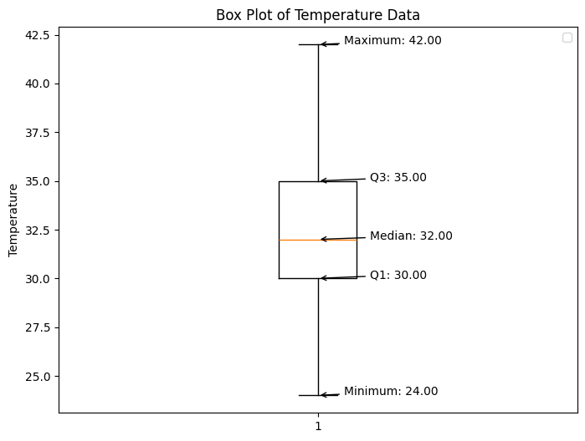
Boxplot & Output
Five Summary Measures:
Minimum: 24
1st Quartile: 30.0
Median: 32.0
3rd Quartile: 35.0
Maximum: 42
Mild Outliers: []
Wild Outliers: []

Slide 4
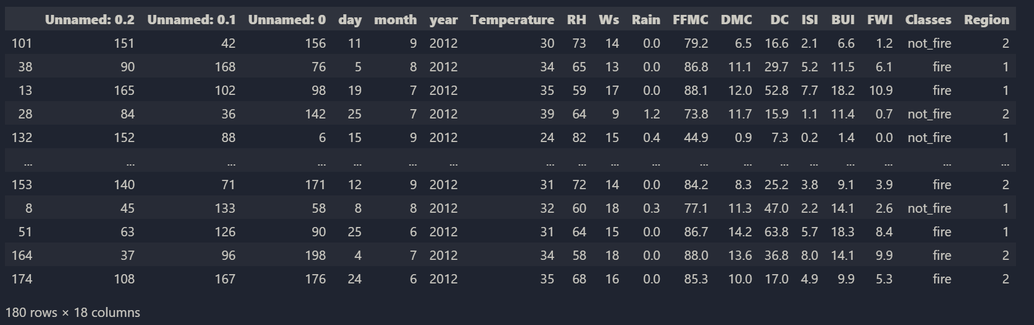
Estimate the Fisher linear discrimination function and the corresponding rule to classify (fire and not fire) based on FWI and RH:

Slide 5
Prediction & Classification of Algerian Fire Data
FWI = 0.21, RH = 79, the classification is: Fire
FWI = 2.50, RH = 67, the classification is: Fire
FWI = 10.2, RH = 63, the classification is: Not Fire
FWI = 6.10, RH = 56, the classification is: Not Fire

Slide 6
Thank You

